Slide 1


Calculus and applications
MTH10012
Week 4

Slide 2
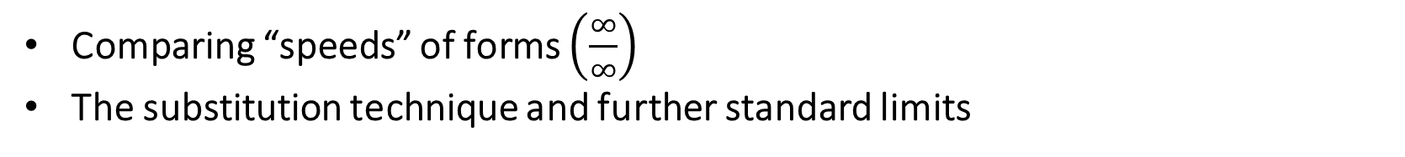
Introduction
Week 3
Infinity and limits, indefinite forms, sandwich theorem, standard limits
Continuity and applications to limits
Week 4
MODULE 2
Comparing “speeds” of forms $\left(\frac{∞}{∞}\right)$
The substitution technique and further standard limits
MODULE 3
Sequences
Limits of sequences (convergent, divergent and irregular sequences)
Limit laws for sequences and simple indefinite forms
Standard limits for sequences

Slide 3
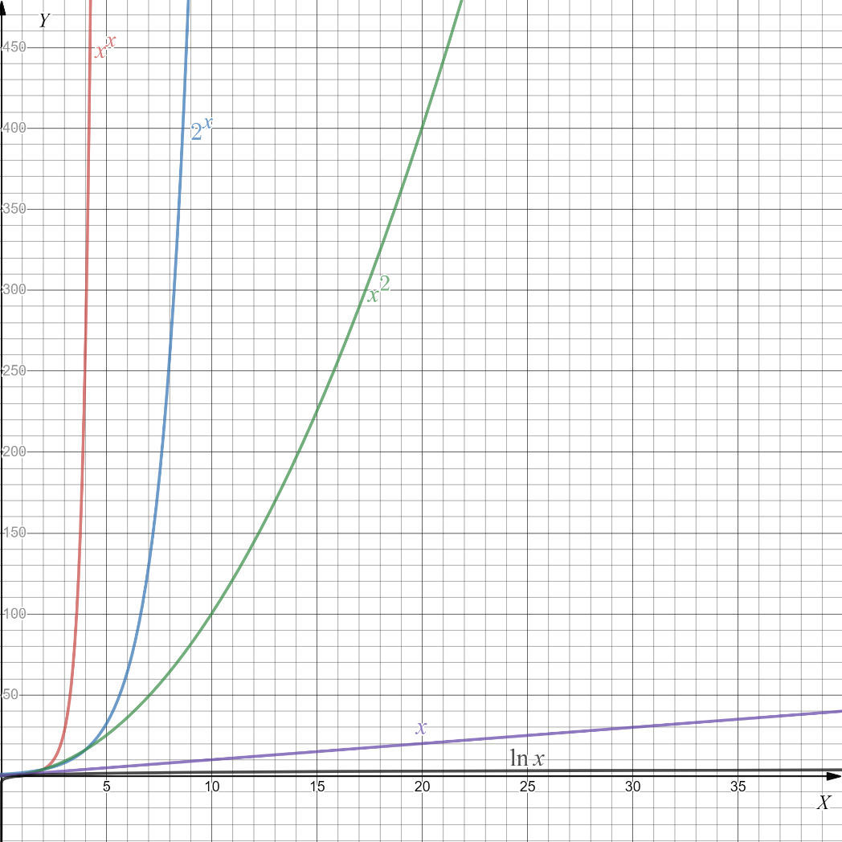
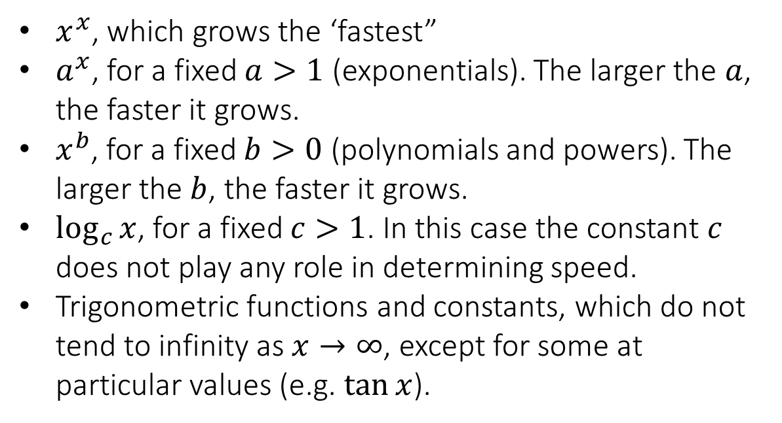
2.8 The “race to infinity”: comparing “speeds” for the $\left(∞/∞\right)$case
Theorem (Speeds at infinity). Given $a,b,c∈ℝ$, when the limit for $x→∞$ is considered, the following functions grow to infinity with different speeds. In order from fastest to slowest:
$x^{x}$, which grows the ‘fastest”
$a^{x}$, for a fixed $a>1$ (exponentials). The larger the $a$, the faster it grows.
$x^{b}$, for a fixed $b>0$ (polynomials and powers). The larger the $b$, the faster it grows.
$\log_{c}{x}$, for a fixed $c>1$. In this case the constant $c$ does not play any role in determining speed.
Trigonometric functions and constants, which do not tend to infinity as $x→∞$, except for some at particular values (e.g. $\tan{x}$).

Slide 4
2.8 The “race to infinity”: comparing “speeds” for the $\left(∞/∞\right)$case
Evaluate the following limit: $\lim_{x→∞}{\frac{\ln{x} +1}{x^{3}+1}}$
Evaluate the following limit: $\lim_{x→∞}{\frac{\sin^{2}{x}}{x^{4}−1}}$

Slide 5
2.8 The “race to infinity”: comparing “speeds” for the $\left(∞/∞\right)$case
Evaluate the following limit: $\lim_{x→∞}{\frac{2+\cos{x}+x^{6}}{x^{4}+\log_{3}x}}$
Evaluate the following limit: $\lim_{x→∞}{\frac{2+\cos{x}+x^{6}}{x^{4}−\log_{3}x}}$

Slide 6
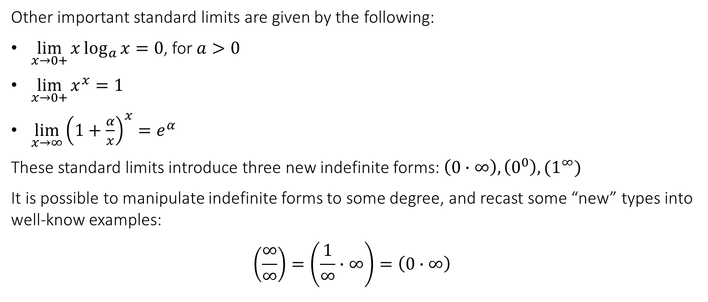
2.9 The substitution technique and further standard limits
Other important standard limits are given by the following:
$\lim_{x→0+}{x\log_{a}{x}}=0$, for $a>0$
$\lim_{x→0+}{x^{x}}=1$
$\lim_{x→∞}{{\left(1+\frac{α}{x}\right)}^{x}=e^{α}}$
These standard limits introduce three new indefinite forms: $\left(0∙∞\right),\left(0^{0}\right),(1^{∞})$
It is possible to manipulate indefinite forms to some degree, and recast some “new” types into well-know examples:
$$\left(\frac{∞}{∞}\right)=\left(\frac{1}{∞}∙∞\right)=\left(0∙∞\right)$$

Slide 7
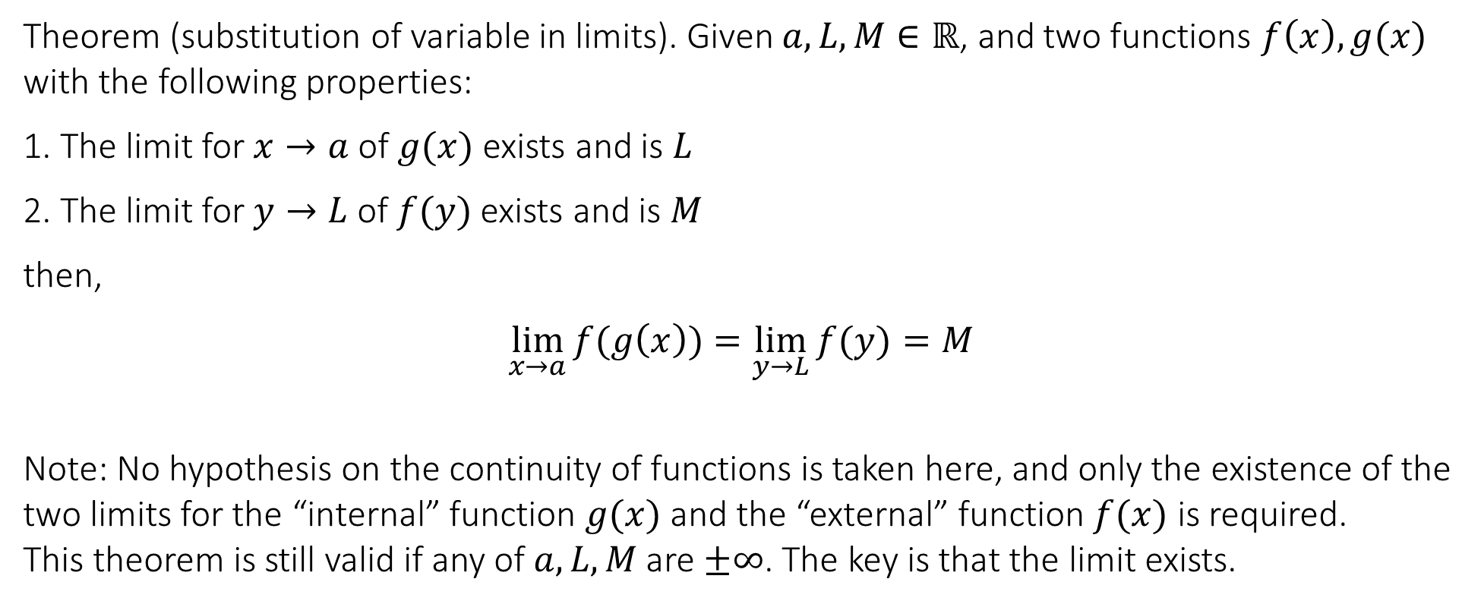
2.9 The substitution technique and further standard limits
Theorem (substitution of variable in limits). Given $a,L,M∈ℝ$, and two functions $f\left(x\right),g(x)$ with the following properties:
1. The limit for $x→a$ of $g(x)$ exists and is $L$
2. The limit for $y→L$ of $f(y)$ exists and is $M$
then,
$$\lim_{x→a}{f(g\left(x\right))}=\lim_{y→L}{f(y)}=M$$
Note: No hypothesis on the continuity of functions is taken here, and only the existence of the two limits for the “internal” function $g(x)$ and the “external” function $f(x)$ is required.
This theorem is still valid if any of $a,L,M$ are $±∞$. The key is that the limit exists.

Slide 8
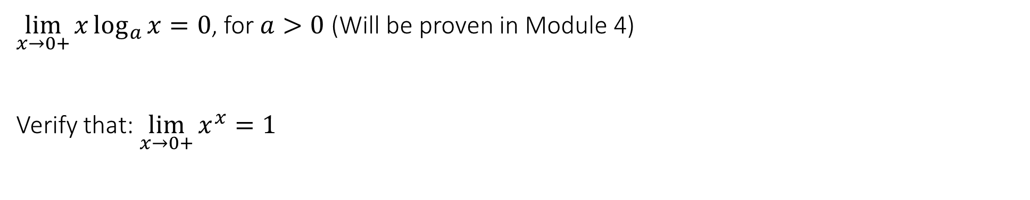
2.9 The substitution technique and further standard limits
$\lim_{x→0+}{x\log_{a}{x}}=0$, for $a>0$ (Will be proven in Module 4)
Verify that: $\lim_{x→0+}{x^{x}}=1$

Slide 9
2.9 The substitution technique and further standard limits
Verify that: $\lim_{x→∞}{{\left(1+\frac{α}{x}\right)}^{x}=e^{α}}$

Slide 10
2.9 The substitution technique and further standard limits
Verify that: $\lim_{x→0+}{{\left(1+x\right)}^{\frac{1}{x}}=e}$
Verify that: $\lim_{x→0}{\frac{a^{x}−1}{x}=\ln{a}}$, for any $a>0$

Slide 11
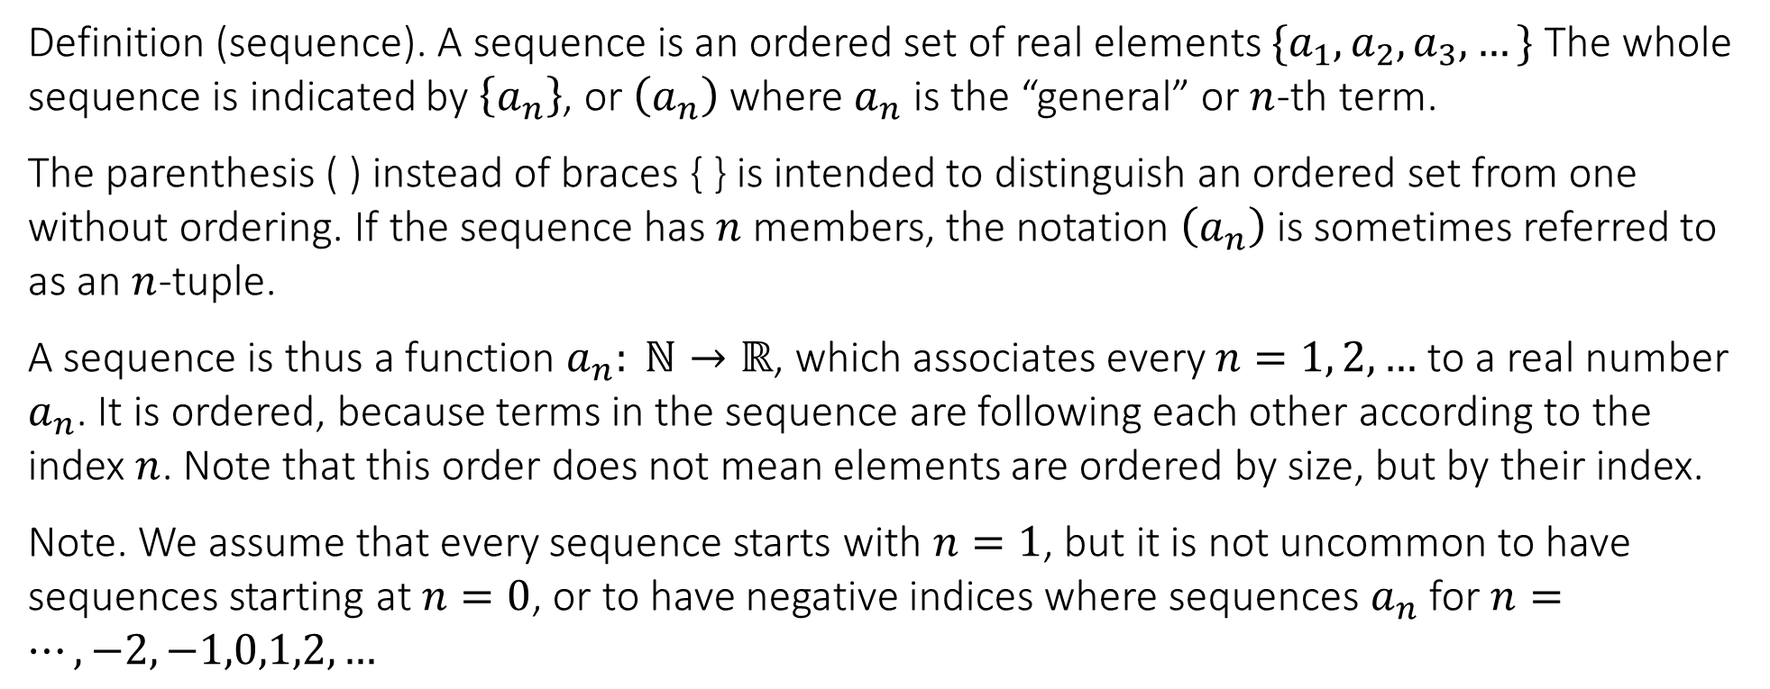
3.1 Sequences
MODULE 3
Definition (sequence). A sequence is an ordered set of real elements $\{a_{1},a_{2},a_{3},…\}$ The whole sequence is indicated by $\left\{a_{n}\right\}$, or $\left(a_{n}\right)$ where $a_{n}$ is the “general” or $n$-th term.
The parenthesis ( ) instead of braces { } is intended to distinguish an ordered set from one without ordering. If the sequence has $n$ members, the notation $\left(a_{n}\right)$ is sometimes referred to as an $n$-tuple.
A sequence is thus a function $a_{n}: ℕ→ℝ$, which associates every $n=1, 2,…$ to a real number $a_{n}$. It is ordered, because terms in the sequence are following each other according to the index $n$. Note that this order does not mean elements are ordered by size, but by their index.
Note. We assume that every sequence starts with $n=1$, but it is not uncommon to have sequences starting at $n=0$, or to have negative indices where sequences $a_{n}$ for $n=…,−2,−1,0,1,2,…$

Slide 12
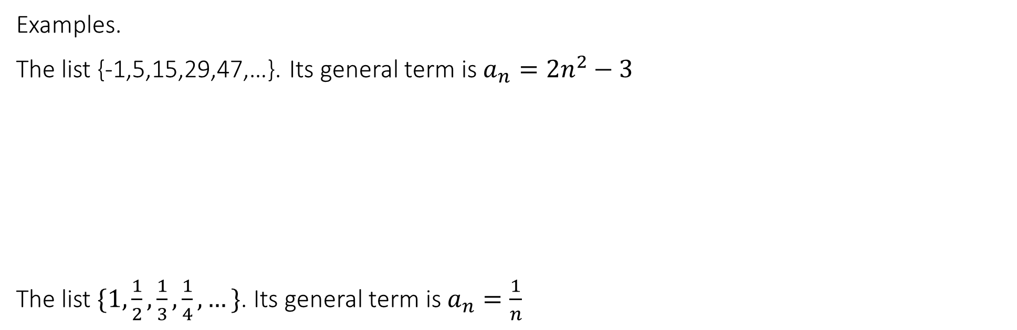
3.1 Sequences
Examples.
The list {-1,5,15,29,47,…}. Its general term is $a_{n}=2n^{2}−3$
The list $\{1,\frac{1}{2},\frac{1}{3},\frac{1}{4},…\}$. Its general term is $a_{n}=\frac{1}{n}$

Slide 13
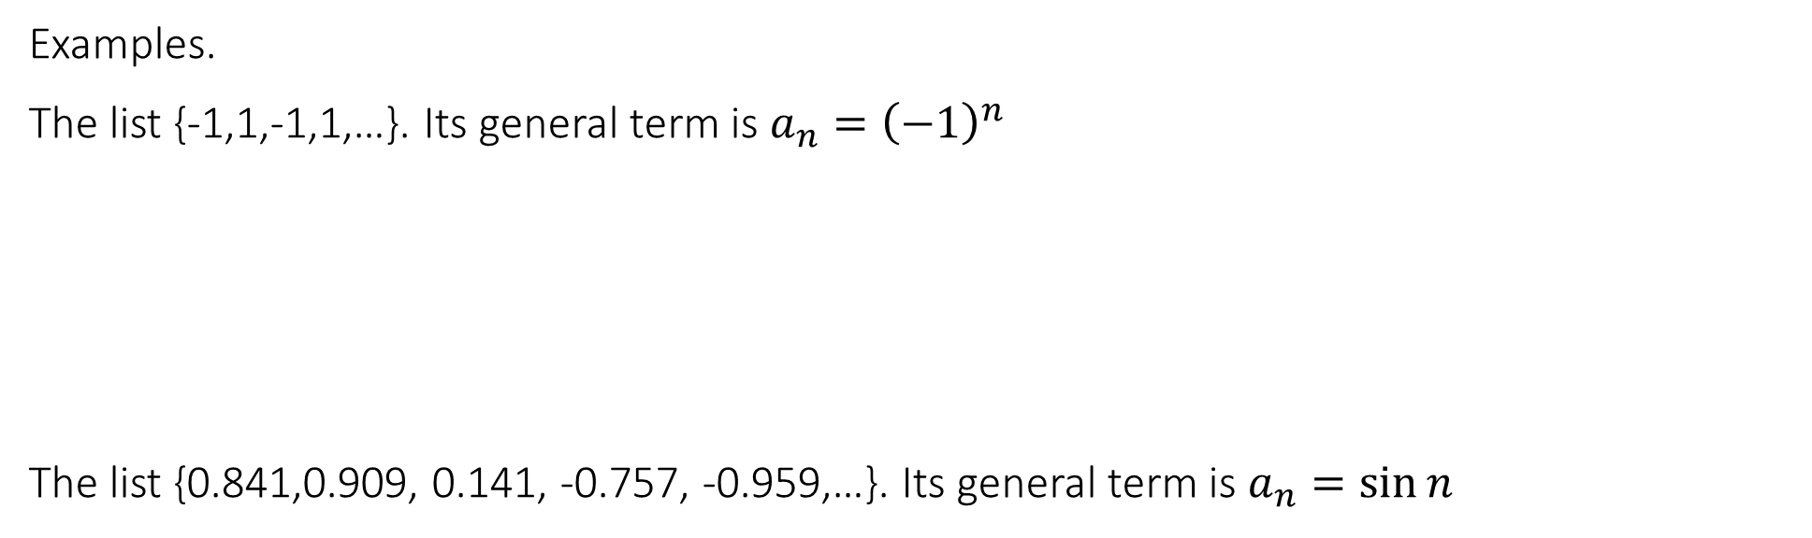
3.1 Sequences
Examples.
The list {-1,1,-1,1,…}. Its general term is $a_{n}={\left(−1\right)}^{n}$
The list {0.841,0.909, 0.141, -0.757, -0.959,…}. Its general term is $a_{n}=\sin{n}$

Slide 14
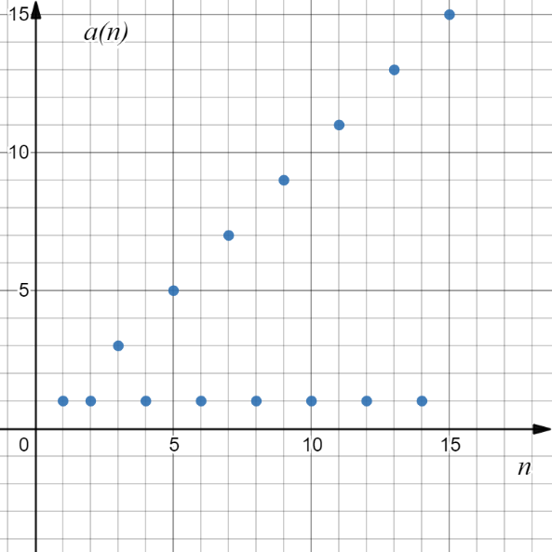
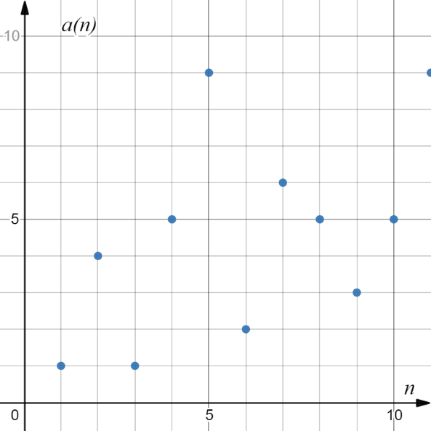
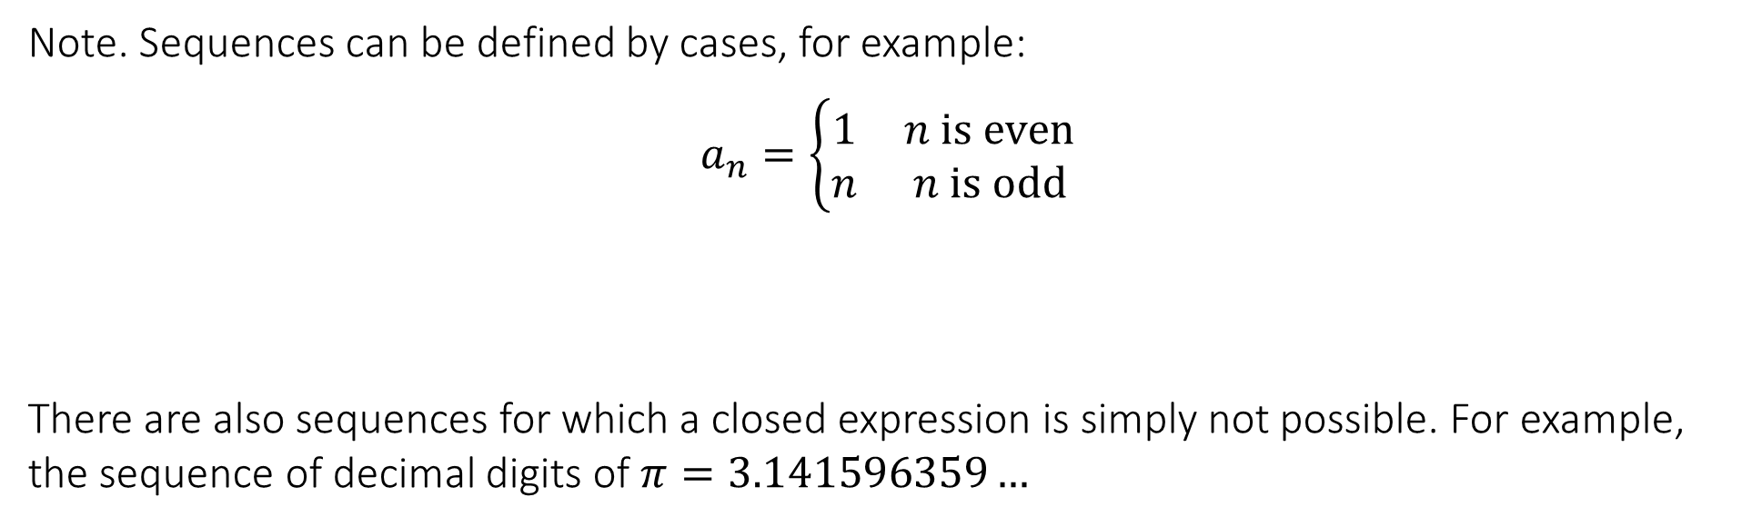
3.1 Sequences
Note. Sequences can be defined by cases, for example:
$$a_{n}=\left\{\begin{matrix}1 & n is even \\ n & n is odd\end{matrix}\right.$$
There are also sequences for which a closed expression is simply not possible. For example, the sequence of decimal digits of $π=3.141596359…$

Slide 15
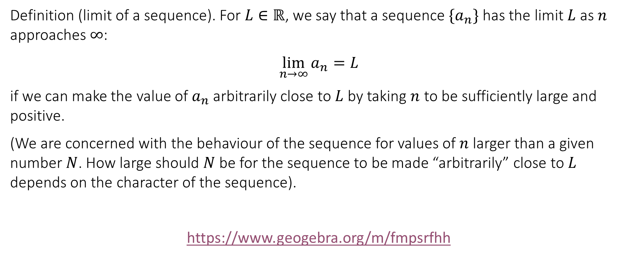
3.2 Limit of sequences
Definition (limit of a sequence). For $L∈ℝ$, we say that a sequence $\{a_{n}\}$ has the limit $L$ as $n$ approaches $∞$:
$$\lim_{n→∞}{a_{n}}=L$$
if we can make the value of $a_{n}$ arbitrarily close to $L$ by taking $n$ to be sufficiently large and positive.
(We are concerned with the behaviour of the sequence for values of $n$ larger than a given number $N$. How large should $N$ be for the sequence to be made “arbitrarily” close to $L$ depends on the character of the sequence).
https://www.geogebra.org/m/fmpsrfhh

Slide 16
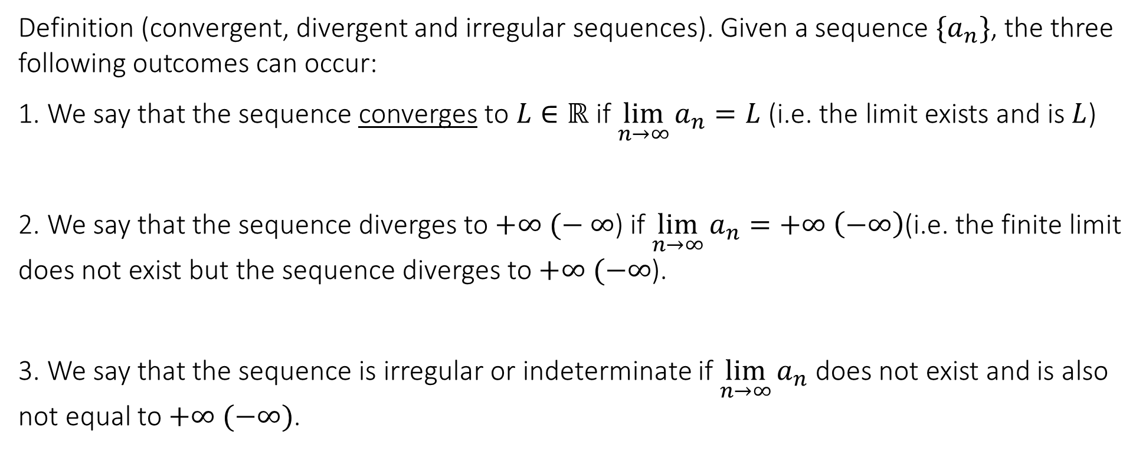
3.2 Limits of sequences
Definition (convergent, divergent and irregular sequences). Given a sequence $\{a_{n}\}$, the three following outcomes can occur:
1. We say that the sequence converges to $L∈ℝ$ if $\lim_{n→∞}{a_{n}}=L$ (i.e. the limit exists and is $L$)
2. We say that the sequence diverges to $+∞ (−$ $∞$) if $\lim_{n→∞}{a_{n}}=+∞ \left(−∞\right)$(i.e. the finite limit does not exist but the sequence diverges to $+∞ (−∞$).
3. We say that the sequence is irregular or indeterminate if $\lim_{n→∞}{a_{n}}$ does not exist and is also not equal to $+∞ (−∞)$.

Slide 17
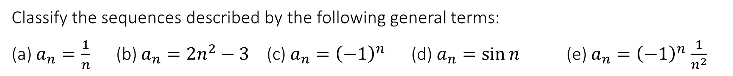
3.2 Limit of sequences
Classify the sequences described by the following general terms:
(a) $a_{n}=\frac{1}{n}$ (b) $a_{n}=2n^{2}−3$ (c) $a_{n}={\left(−1\right)}^{n}$ (d) $a_{n}=\sin{n}$ (e) $a_{n}={\left(−1\right)}^{n}$ $\frac{1}{n^{2}}$

Slide 18
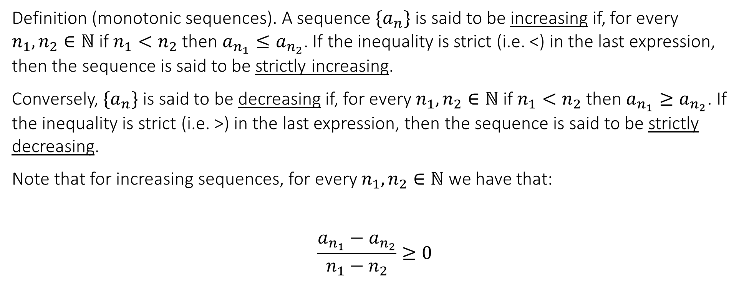
3.2 Limit of sequences
Definition (monotonic sequences). A sequence $\{a_{n}\}$ is said to be increasing if, for every $n_{1},n_{2}∈ℕ$ if $n_{1}<n_{2}$ then $a_{n_{1}}≤a_{n_{2}}$. If the inequality is strict (i.e. <) in the last expression, then the sequence is said to be strictly increasing.
Conversely, $\{a_{n}\}$ is said to be decreasing if, for every $n_{1},n_{2}∈ℕ$ if $n_{1}<n_{2}$ then $a_{n_{1}}≥a_{n_{2}}$. If the inequality is strict (i.e. >) in the last expression, then the sequence is said to be strictly decreasing.
Note that for increasing sequences, for every $n_{1},n_{2}∈ℕ$ we have that:
$$\frac{a_{n_{1}}−a_{n_{2}}}{n_{1}−n_{2}}≥0$$

Slide 19
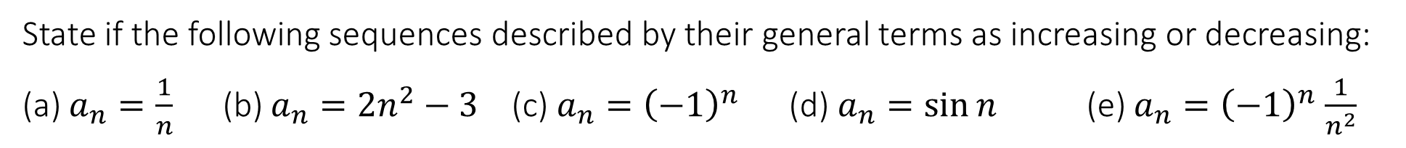
3.2 Limit of sequences
State if the following sequences described by their general terms as increasing or decreasing:
(a) $a_{n}=\frac{1}{n}$ (b) $a_{n}=2n^{2}−3$ (c) $a_{n}={\left(−1\right)}^{n}$ (d) $a_{n}=\sin{n}$ (e) $a_{n}={\left(−1\right)}^{n}$ $\frac{1}{n^{2}}$

Slide 20
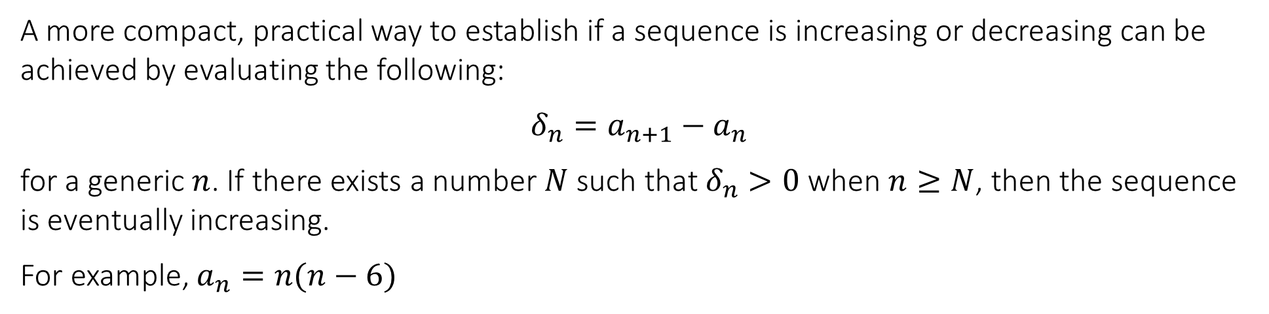
3.2 Limit of sequences
A more compact, practical way to establish if a sequence is increasing or decreasing can be achieved by evaluating the following:
$$δ_{n}=a_{n+1}−a_{n}$$
for a generic $n$. If there exists a number $N$ such that $δ_{n}>0$ when $n≥N$, then the sequence is eventually increasing.
For example, $a_{n}=n(n−6)$

Slide 21
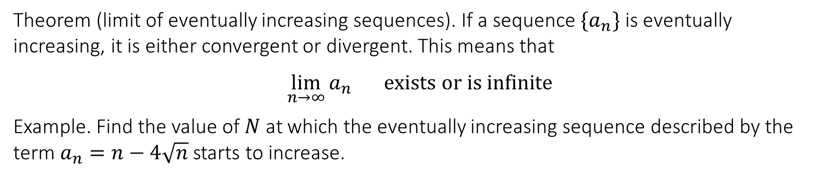
3.2 Limit of sequences
Theorem (limit of eventually increasing sequences). If a sequence $\{a_{n}\}$ is eventually increasing, it is either convergent or divergent. This means that
$$\lim_{n→∞}{a_{n}} exists or is infinite$$
Example. Find the value of $N$ at which the eventually increasing sequence described by the term $a_{n}=n−4\sqrt{n}$ starts to increase.

Slide 22
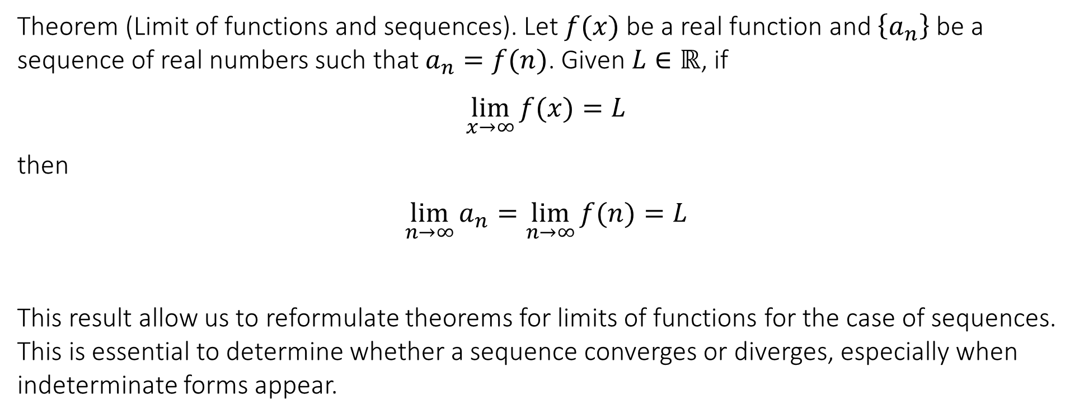
3.3 Limits laws for sequences and simple indefinite forms
Theorem (Limit of functions and sequences). Let $f(x)$ be a real function and $\left\{a_{n}\right\}$ be a sequence of real numbers such that $a_{n}=f(n)$. Given $L∈ℝ$, if
$$\lim_{x→∞}{f(x)}=L$$
then
$$\lim_{n→∞}{a_{n}}=\lim_{n→∞}{f(n)}=L$$
This result allow us to reformulate theorems for limits of functions for the case of sequences. This is essential to determine whether a sequence converges or diverges, especially when indeterminate forms appear.

Slide 23
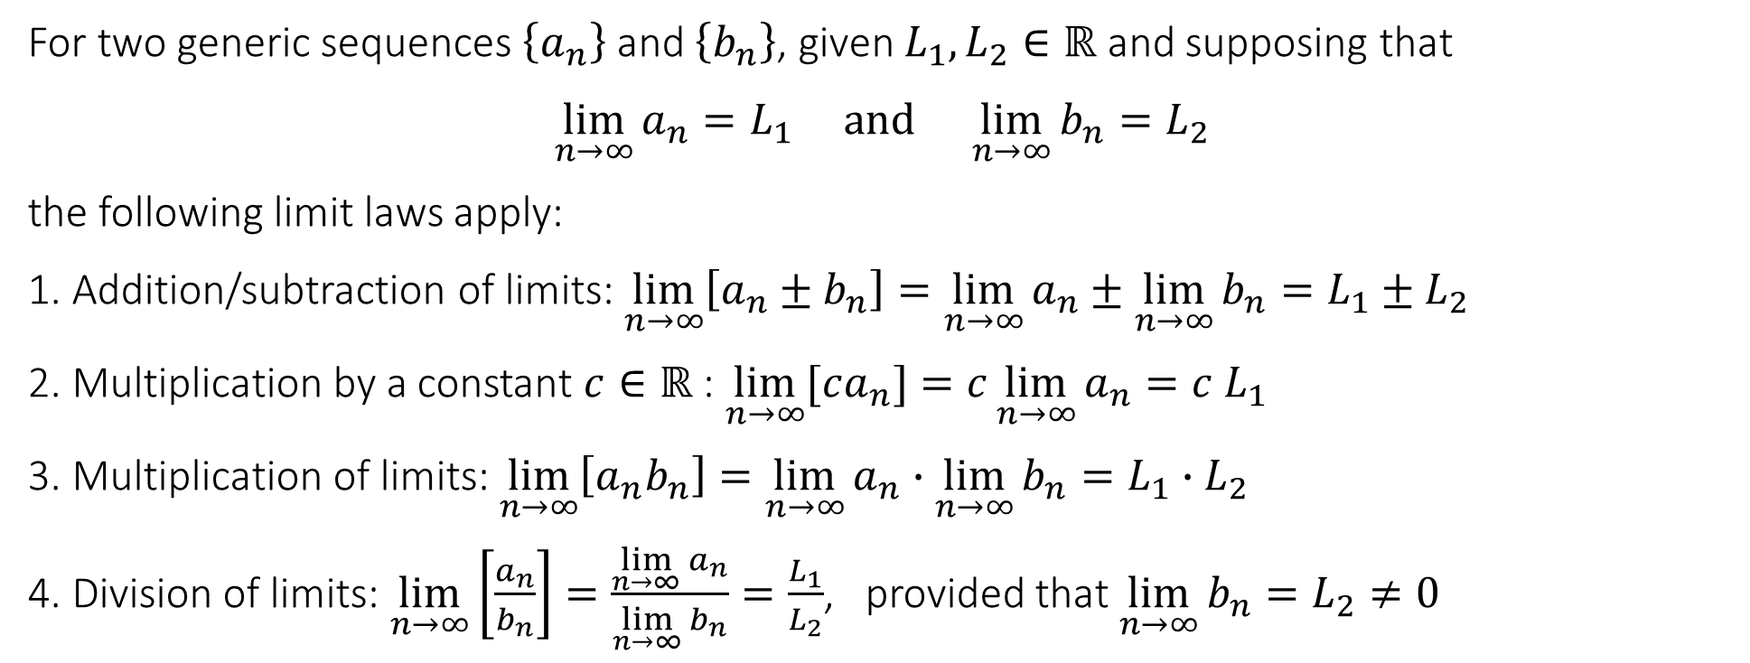
3.3 Limits laws for sequences and simple indefinite forms
For two generic sequences $\left\{a_{n}\right\}$ and $\left\{b_{n}\right\}$, given $L_{1},L_{2}∈ℝ$ and supposing that
$$\lim_{n→∞}{a_{n}}=L_{1} and \lim_{n→∞}{b_{n}}=L_{2}$$
the following limit laws apply:
1. Addition/subtraction of limits: $\lim_{n→∞}\left[a_{n}±b_{n}\right]=\lim_{n→∞}{a_{n}}±\lim_{n→∞}{b_{n}}=L_{1}±L_{2}$
2. Multiplication by a constant $c∈ℝ$ : $\lim_{n→∞}{[ca_{n}]}=c\lim_{n→∞}{a_{n}}={c L}_{1}$
3. Multiplication of limits: $\lim_{n→∞}\left[a_{n}b_{n}\right]=\lim_{n→∞}{a_{n}}∙\lim_{n→∞}{b_{n}}=L_{1}∙L_{2}$
4. Division of limits: $\lim_{n→∞}\left[\frac{a_{n}}{b_{n}}\right]=\frac{\lim_{n→∞}{a_{n}}}{\lim_{n→∞}{b_{n}}}=\frac{L_{1}}{L_{2}}$, provided that $\lim_{n→∞}{b_{n}}=L_{2}≠0$

Slide 24
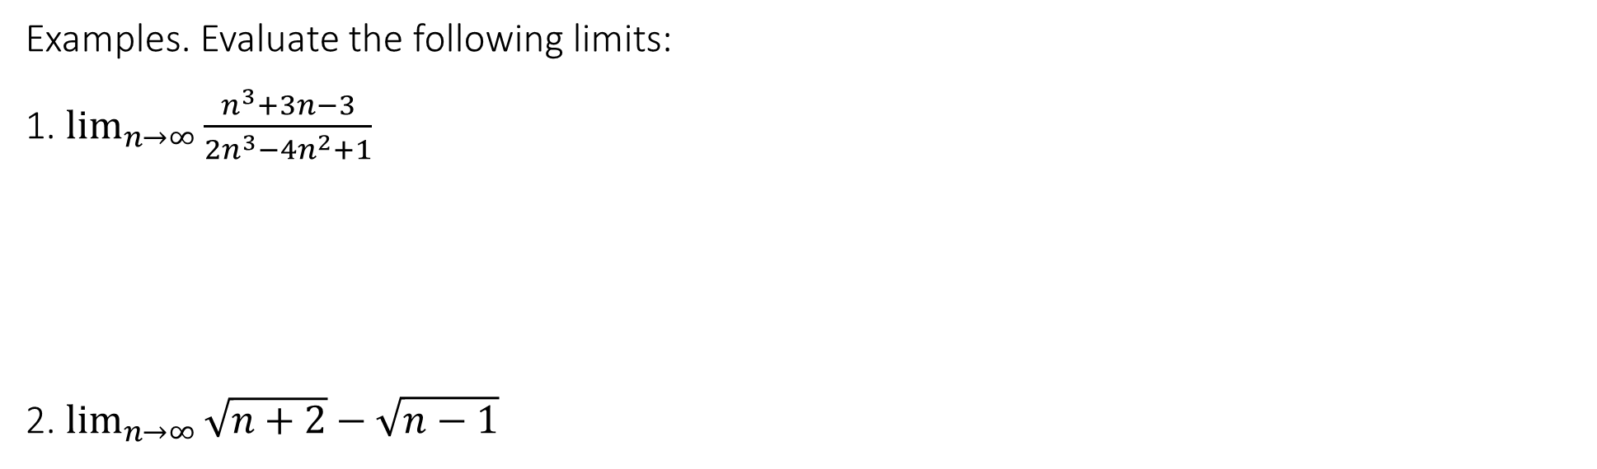
3.3 Limits laws for sequences and simple indefinite forms
Examples. Evaluate the following limits:
1. $\lim_{n→∞}{\frac{n^{3}+3n−3}{2n^{3}−4n^{2}+1}}$
2. $\lim_{n→∞}{\sqrt{n+2}−\sqrt{n−1}}$

Slide 25
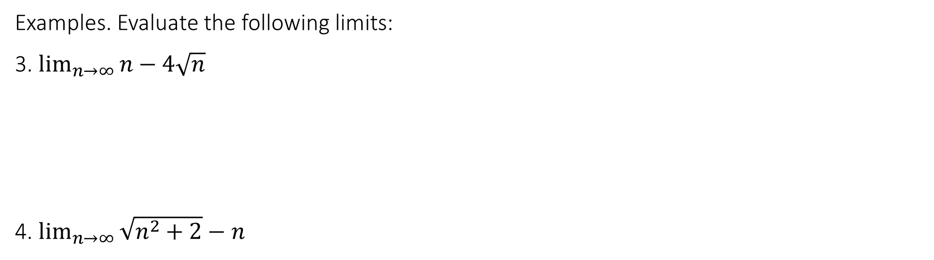
3.3 Limits laws for sequences and simple indefinite forms
Examples. Evaluate the following limits:
3. $\lim_{n→∞}{n−4\sqrt{n}}$
4. $\lim_{n→∞}{\sqrt{n^{2}+2}−n}$

Slide 26

3.4 Standard limits and “speeds” for sequences
The considerations on “speeds” of functions can also be adapted for sequences.
Theorem (Standard limits for sequences).
1. $\lim_{n→∞}{r^{n}}=0$, for any $\left|r\right|<1$
2. $\lim_{n→∞}{a^{\frac{1}{n}}}=1$, for any $a>0$

Slide 27

3.4 Standard limits and “speeds” for sequences
3. $\lim_{n→∞}{n^{\frac{1}{n}}}=1$
4. $\lim_{n→∞}{{\left(1+\frac{α}{n}\right)}^{n}}=e^{α}$, for any $α∈ℝ$
5. $\lim_{n→∞}{\frac{a^{n}}{n!}}=0$, for any $a>0$

Slide 28

3.4 Standard limits and “speeds” for sequences
6. $\lim_{n→∞}{\frac{\log_{a}{n}}{n^{p}}}=0$, for any $a>0$, any $p>0$
7. $\lim_{n→∞}{\frac{n^{p}}{a^{n}}}=0$, for any $a>1,$ any $p>0$
8. $\lim_{n→∞}{\frac{n!}{n^{n}}}=0$

Slide 29
End of Lecture

